Slide 1
Collaboration-Based Design
Dirk Riehle, FAU Erlangen
ADAP D04
Licensed under CC BY 4.0 International

Slide 2
Agenda
Collaborations in UML
File system collaborations
Collaboration and class models
History and related concepts
The role object pattern

Slide 3
1. Collaborations in UML

Slide 4
Collaboration-Based Design
Collaboration-based design is
An approach to modeling and implementing using collaborations
A collaboration specification (UML: Collaboration) is
A model of how objects collaborate for a particular purpose
A collaboration instance (UML: Collaboration Use) is
A set of objects collaborating according to a collaboration specification
A role specification (UML: Role) is
A model of the behavior of one object in a collaboration instance

Slide 5
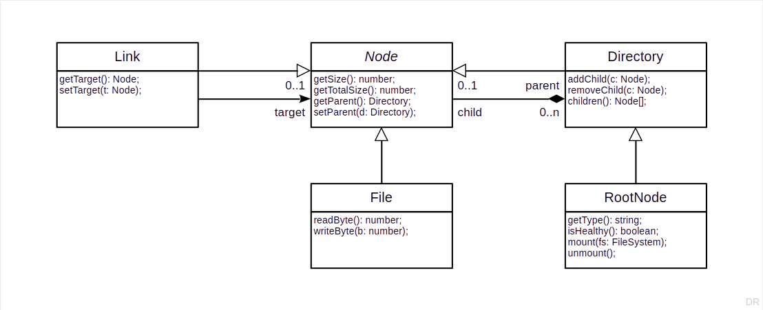
File System Example Revisited

Slide 6
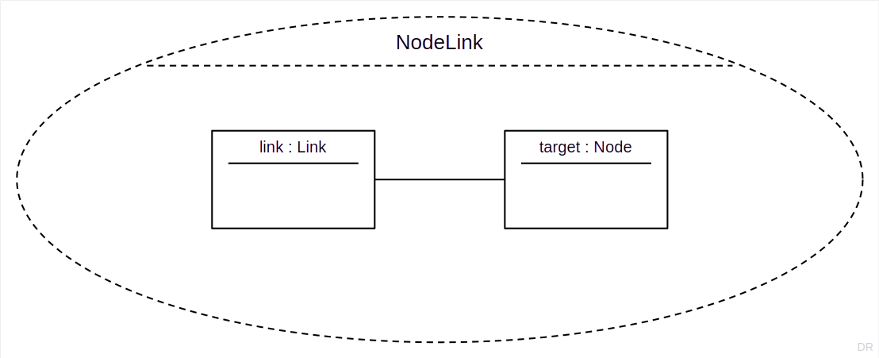
Collaboration Example (UML)

Slide 7
Collaboration as Code
export class Link extends Node {
protected target: Node | null = null;
constructor(bn: string, pn: Directory, tn?: Node) {
super(bn, pn);
if (tn != undefined) {
this.target = tn;
}
}
public getTarget(): Node | null {
return this.target;
}
public setTarget(target: Node): void {
this.target = target;
}
...
}
export class Node {
...
}

Slide 8
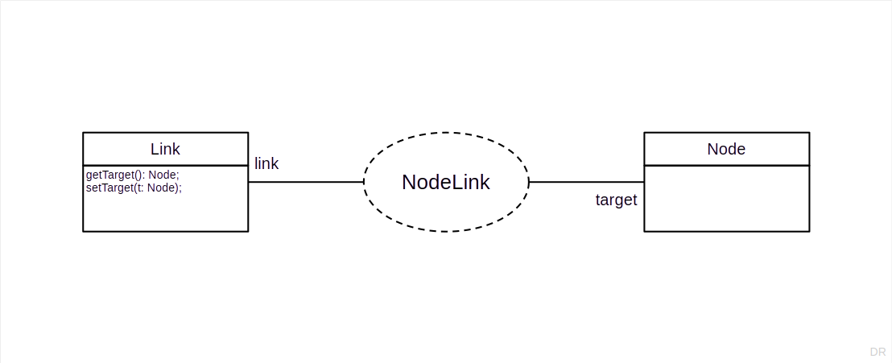
Collaboration Role Binding Example (UML)

Slide 9
Collaboration Roles as Code
export interface NodeLinkLink {
getTarget(): NodeLinkTarget | null;
setTarget(target: NodeLinkTarget): void;
}
export class Link extends Node implements NodeLinkLink {
protected target: NodeLinkTarget | null = null;
constructor(bn: string, pn: Directory, tn?: Node) {
super(bn, pn);
if (tn != undefined) {
this.target = tn;
}
}
public getTarget(): NodeLinkTarget | null {
return this.target;
}
public setTarget(target: NodeLinkTarget): void {
this.target = target;
}
...
}
export interface NodeLinkTarget {
// no methods
}
export class Node implements NodeLinkTarget {
protected baseName: string = "";
protected parentNode: Directory;
constructor(bn: string, pn: Directory) {
this.doSetBaseName(bn);
this.parentNode = pn;
this.initialize(pn);
}
protected initialize(pn: Directory): void {
this.parentNode = pn;
this.parentNode.addChild(this);
}
protected doSetBaseName(bn: string): void {
this.baseName = bn;
}
...
}

Slide 10
Collaboration as Code (as Language Construct)
export collaboration NodeLink {
role Link {
protected target: Target | null = null;
constructor(tn?: Target) {
if (tn != undefined) {
this.target = tn;
}
}
public getTarget(): Target | null {
return this.target;
}
public setTarget(target: Target): void {
this.target = target;
}
}
role Target {
// no methods
}
}
import { NodeLink.Target } from "./NodeLink";
export class Node implements NodeLink.Target {
...
}
----------------------------------------
import * as NodeLink from "./NodeLink";
export class Link extends Node implements NodeLink.Link {
protected target: NodeLink.Target | null = null;
...
public getTarget(): NodeLink.Target | null {
return this.target;
}
public setTarget(target: NodeLink.Target): void {
this.target = target;
}
...
}

Slide 11
Semantics of Collaboration “Implementation”
export collaboration NodeLink {
role Link {
protected target: Target | null = null;
constructor(tn?: Target) {
if (tn != undefined) {
this.target = tn;
}
}
public getTarget(): Target | null {
return this.target;
}
public setTarget(target: Target): void {
this.target = target;
}
}
role Target {
// no methods
}
}
import { NodeLink.Target } from "./NodeLink";
export class Node implements NodeLink.Target {
...
}
----------------------------------------
import * as NodeLink from "./NodeLink";
export class Link extends Node implements NodeLink.Link {
protected target: NodeLink.Target | null = null;
...
public getTarget(): NodeLink.Target | null {
return this.target;
}
public setTarget(target: NodeLink.Target): void {
this.target = target;
}
...
}
?

Slide 12
Benefits of Collaboration-Based Design
Separation of concerns
Better reusable models (potentially)

Slide 13
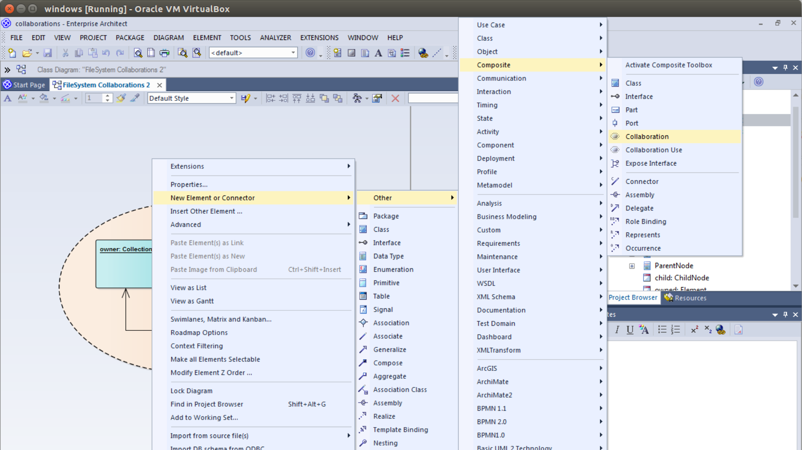
Reality Check: UML Collaboration in Sparx EA

Slide 14
2. File System Collaborations

Slide 15
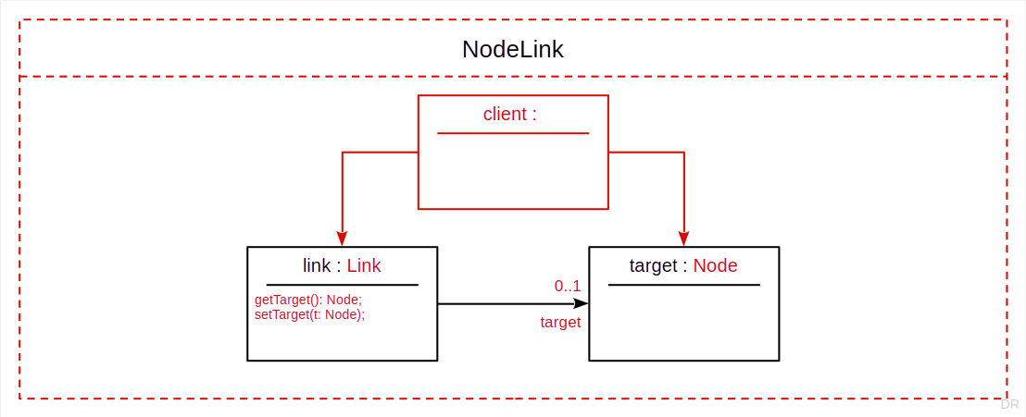
Node Link Collaboration (Riehle’s UML Extension)

Slide 16
Collaborations in File System Example
Node collaboration
NodeLink collaboration
File collaboration
ParentChild collaboration (a.k.a. Composite pattern)
RootNode collaboration

Slide 17
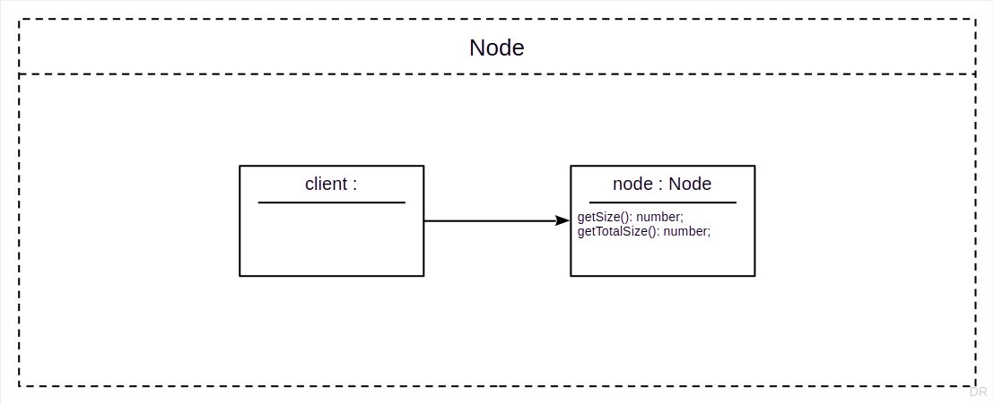
Node Collaboration

Slide 18
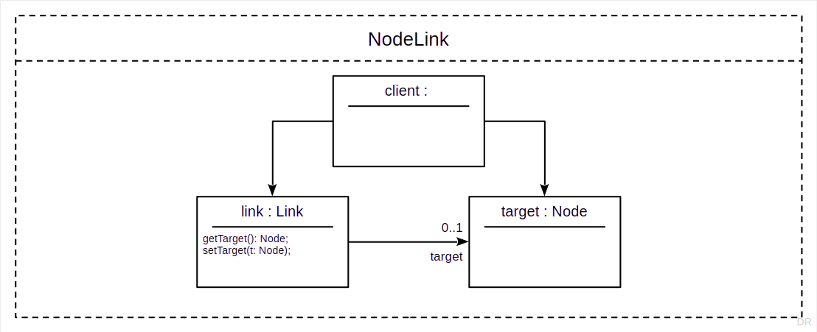
NodeLink Collaboration

Slide 19
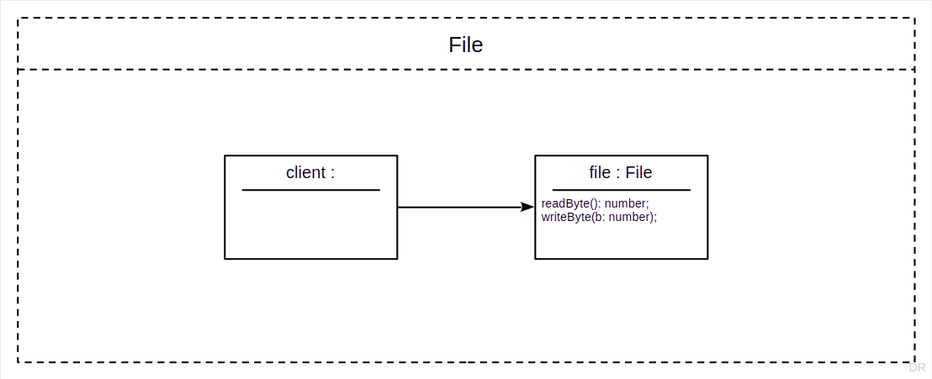
File Collaboration

Slide 20
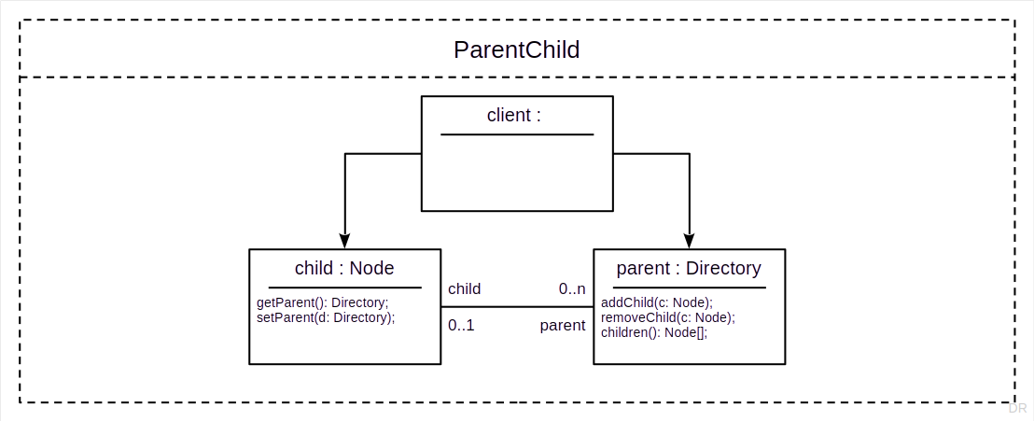
Parent / Child Collaboration

Slide 21
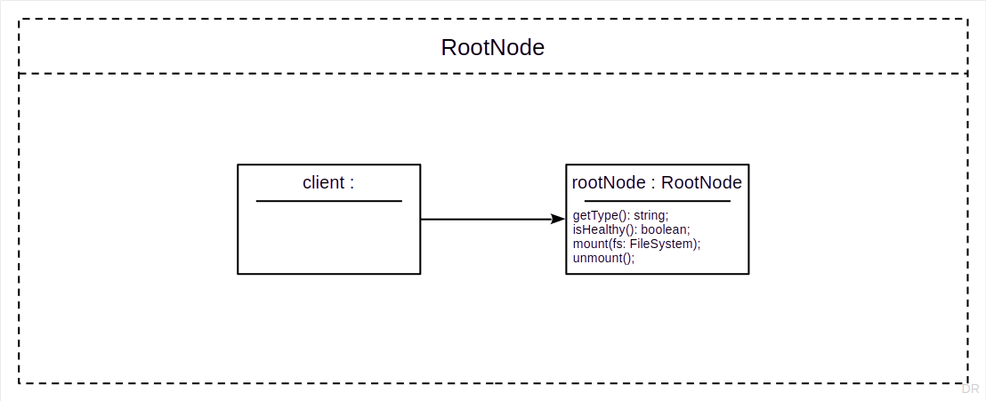
RootNode Collaboration

Slide 22
Types of Collaborations
Primary service collaborations
Typically simple client / service collaborations
The client role often has no methods
Are visible to the outside (use-clients)
Maintenance collaborations
Maintain the domain logic within the model
Often follow design pattern logic
Often not visible to the outside (no use-clients)

Slide 23
3. Collaboration and Class Models

Slide 24
Collaborations / Roles vs. Class Models / Classes
Collaborations
Focus on behavior
Roles
Are part of collaborations
Compose classes from parts
Use use-client interface
Class models
Focus on structure
Classes
Are part of class hierarchies
Compose classes by inheritance
Use inheritance interface

Slide 25
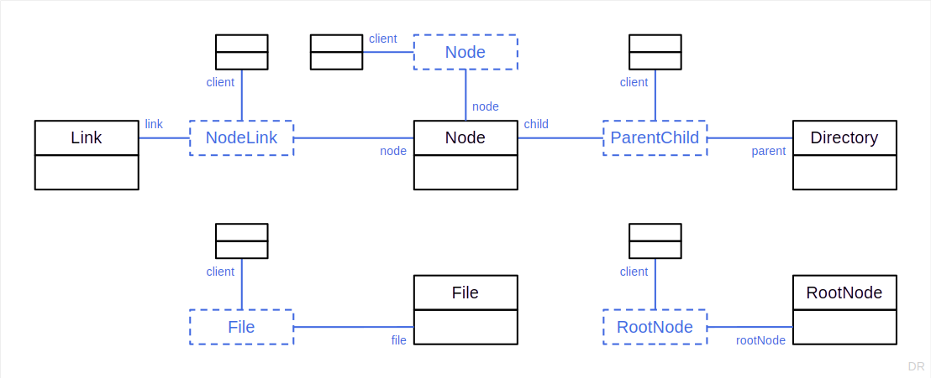
Collaboration Role to Class Assignments

Slide 26
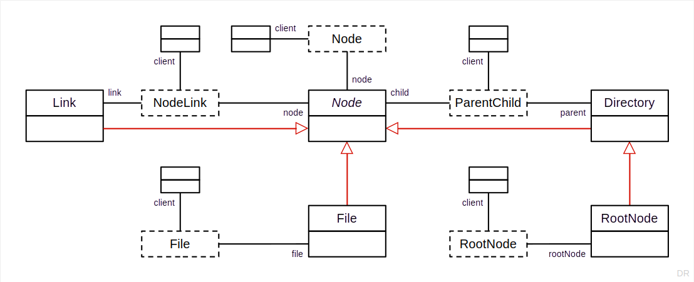
Collaborations with Class Hierarchy

Slide 27
Role and Class Duality
A role specification ties a class into a collaboration context
Control flow enters and leaves through a role
A class composes behavior in multiple contexts into one unit
Role implementation is mapped onto implementation state

Slide 28
Levels of Abstraction
Design patterns
No modeling support
Design templates
UML Collaboration
Class models
UML Class Model

Slide 29
4. History and Related Concepts

Slide 30
History of Collaboration Modeling Methods
Trygve Reenskaug, Role Modeling [1]
Dirk Riehle, Framework Design [2]
OMG, UML 2.0 Specification [3]
[1] Reenskaug, T., Wold, P., & Lehne, O. A. (1996). Working with Objects. Manning.
[2] Riehle, D. (2000). Framework Design: A Role Modeling Approach. Dissertation, no. 13509. Swiss Federal Institute of Technology at Zurich (ETH Zurich), Zurich, Switzerland.
[3] OMG (2005). Unified Modeling Language 2.0. OMG.

Slide 31
Related Concepts from Programming Language History
Past attempts
Interfaces
Protocols
Mix-ins
Traits
Common to all is that they ignore the collaboration, focus only on roles

Slide 32
5. The Role Object Pattern

Slide 33
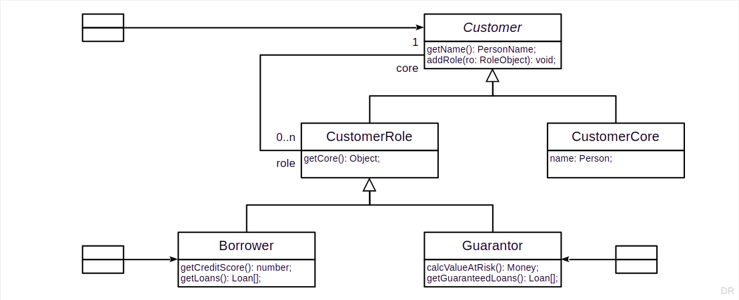
Role Object Example
[1] Bäumer, D., Riehle, D., Siberski, W. & Wulf, M. (2000). Role Object. In Pattern Languages of Program Design 4 (PLoPD 4), pp. 15-32. Addison-Wesley.

Slide 34
Role Object Pattern
Context
A large modular system with core domain concepts and varied applications
Problem
A core concept needs to show a different face in each application
Solution
Extend the core concept with separate role objects facing the application

Slide 35
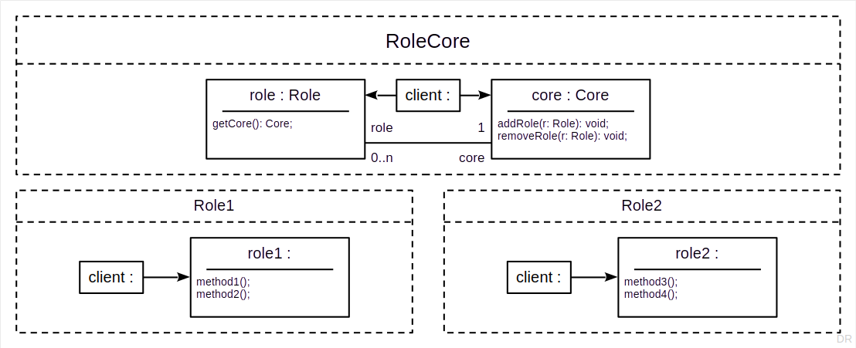
Role Object Collaborations

Slide 36
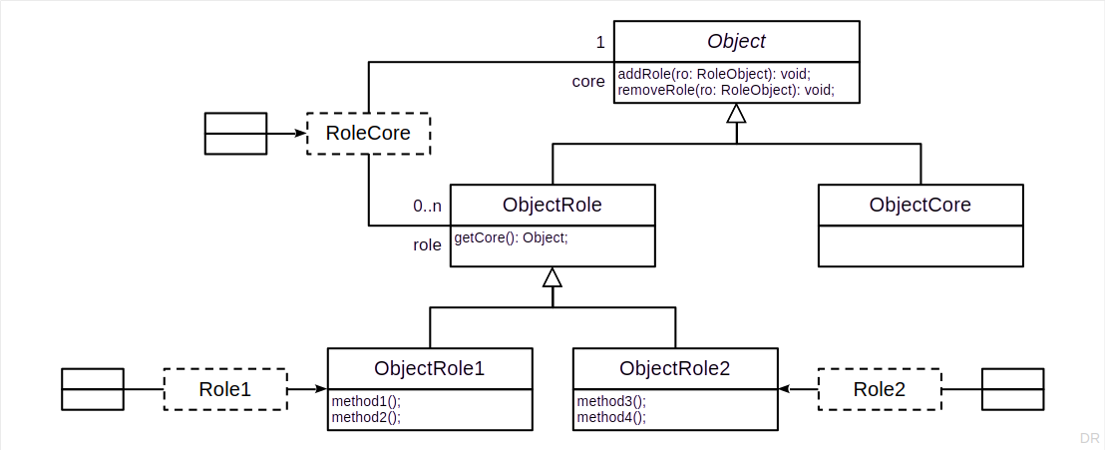
Role Object Structure Diagram

Slide 37
Role Objects vs. Collaborations
The role object pattern
Can be described using collaborations
Allows for dynamic role playing
Simplifies persistence

Slide 38
Summary
Collaboration in UML
File system collaborations
Collaboration and class models
History and related concepts
The Role Object pattern

Slide 39
Thank you! Any questions?
dirk.riehle@fau.de – https://oss.cs.fau.de
dirk@riehle.org – https://dirkriehle.com – @dirkriehle

Slide 40
Legal Notices
License
Licensed under the CC BY 4.0 International license
Copyright
© 2012, 2018, 2025 Dirk Riehle, some rights reserved

